Slide 1


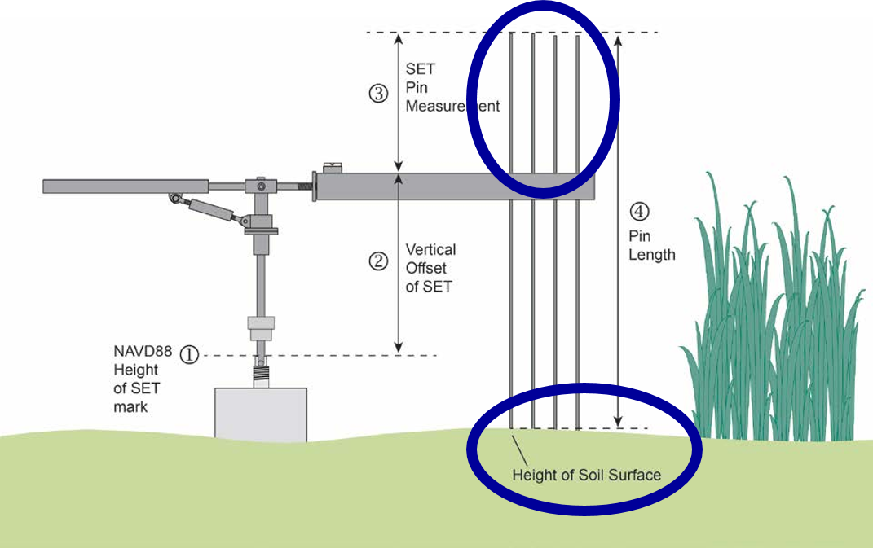
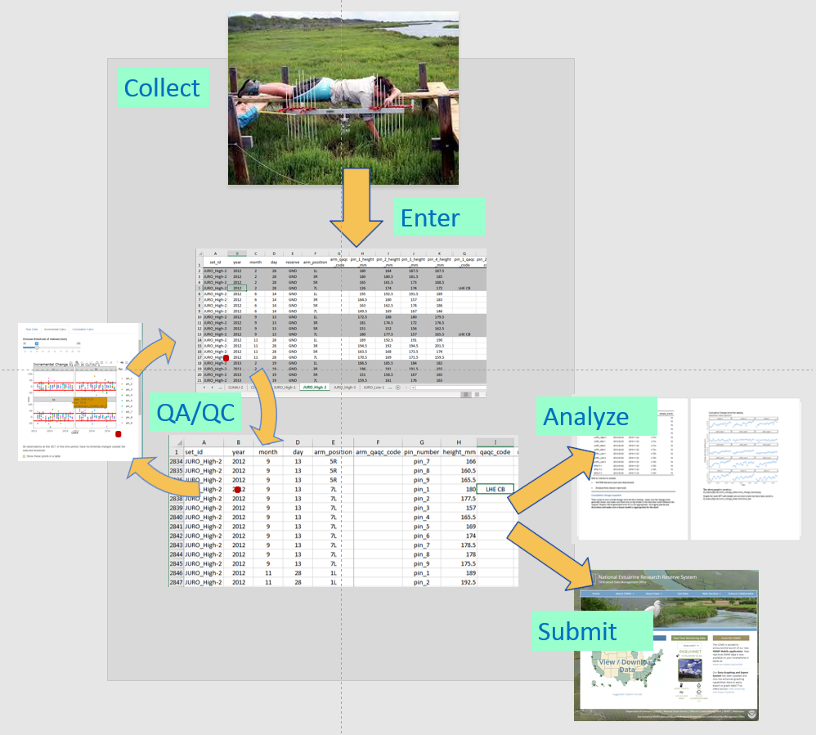
Using R to analyze, understand, and communicate tidal wetland data
Kim Cressman, Grand Bay National Estuarine Research Reserve Kimberly.Cressman@dmr.ms.gov
Working example: https://github.com/swmpkim/SETr_example_reserve_pkg
more info
back to
cover slide
Suzanne Shull, Padilla Bay NERR; Margo Posten, Grand Bay NERR; Kristin Evans, Mission Aransas NERR; Jenni Schmitt, South Slough NERR; Kari St. Laurent, Delaware NERR; Megan Tyrrell, Waquoit Bay NERR; Brook Russell, Clemson University
The Problem: same type of data; many different formats
This Project:
tidied SET data from 15 National Estuarine Research Reserves (NERRs)
generated a workflow that can be used to keep things tidy:
Think about the users!
This project’s end users don’t have much, if any, programming experience.
The Data:
Surface Elevation Tables, aka SETs
file setup: self-contained (.Rproj); descriptive folder and file names
Question: is the marsh surface keeping up with sea level change?
inputs: Excel files
outputs: interactive (shiny, leaflet) and static (Word, from rmarkdown)
help with QA/QC
perform basic analyses
generate documents that are useful communication tools
Pin heights (36 per date, top blue circle) are a proxy for shape and height of the marsh surface (bottom blue circle).
Over time, we can use these data to see how the marsh surface is changing. Marshes provide valuable services, such as flood protection and nursery habitat for seafood species. We want to see them keeping up with sea level rise!
instructions: everywhere
installation help: scripts to install and check for required packages
See and download other NERR data:
http://nerrsdata.org
This work is sponsored by the National Estuarine Research Reserve System Science Collaborative, which supports collaborative research that addresses coastal management problems important to the reserves. The Science Collaborative is funded by the National Oceanic and Atmospheric Administration and managed by the University of Michigan Water Center (NAI4NOS4190145). More info: http://nerrssciencecollaborative.org/

Slide 2
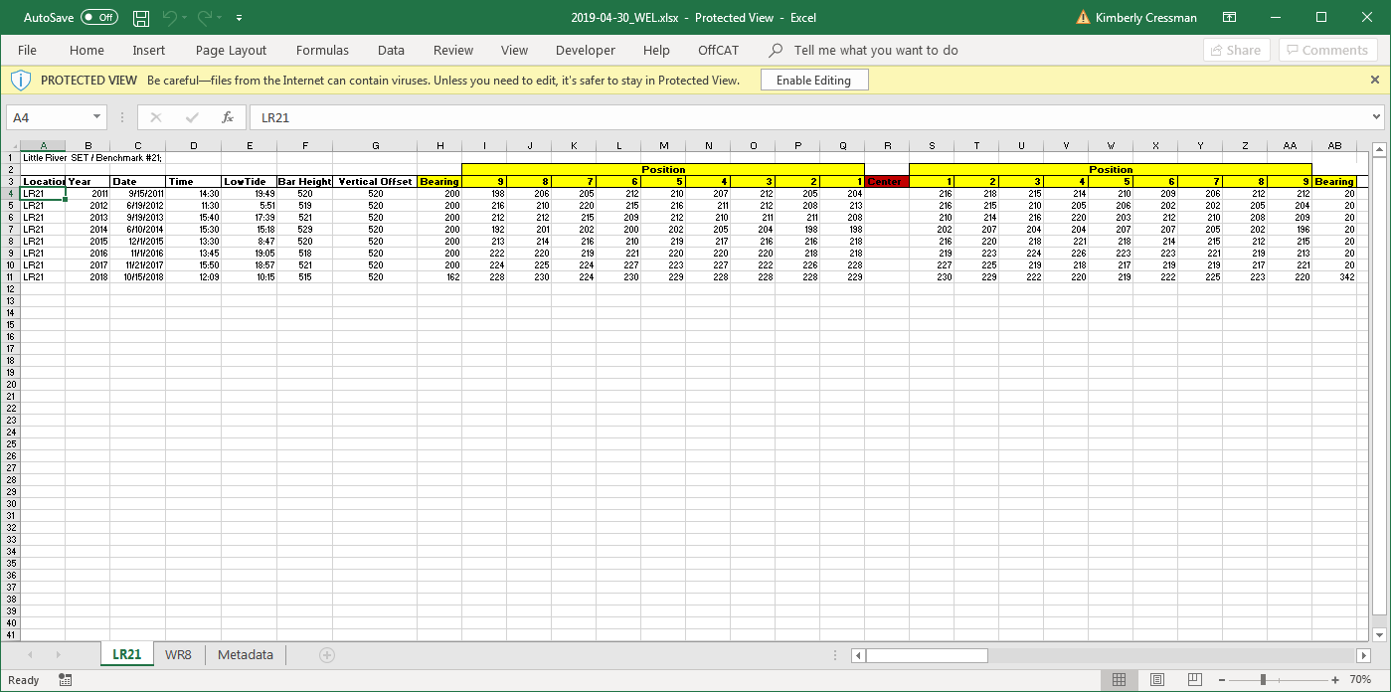
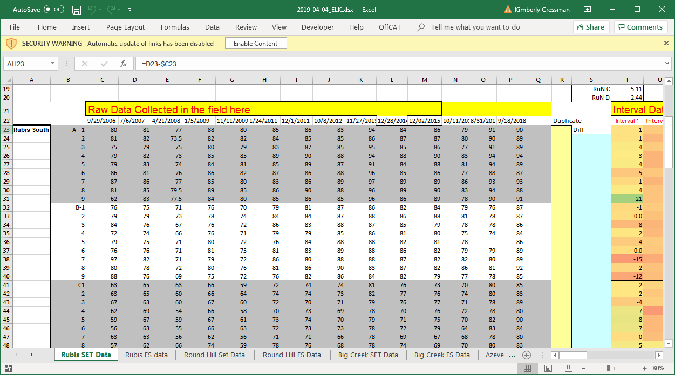
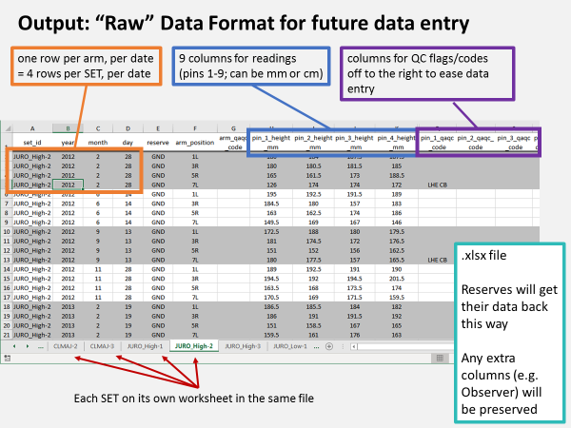
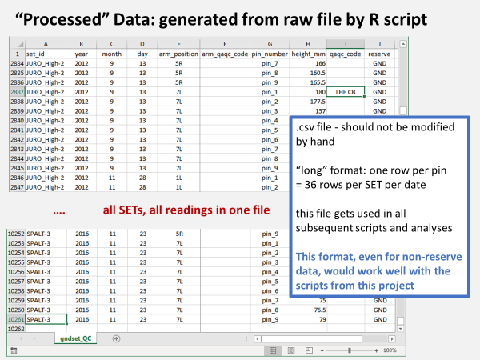
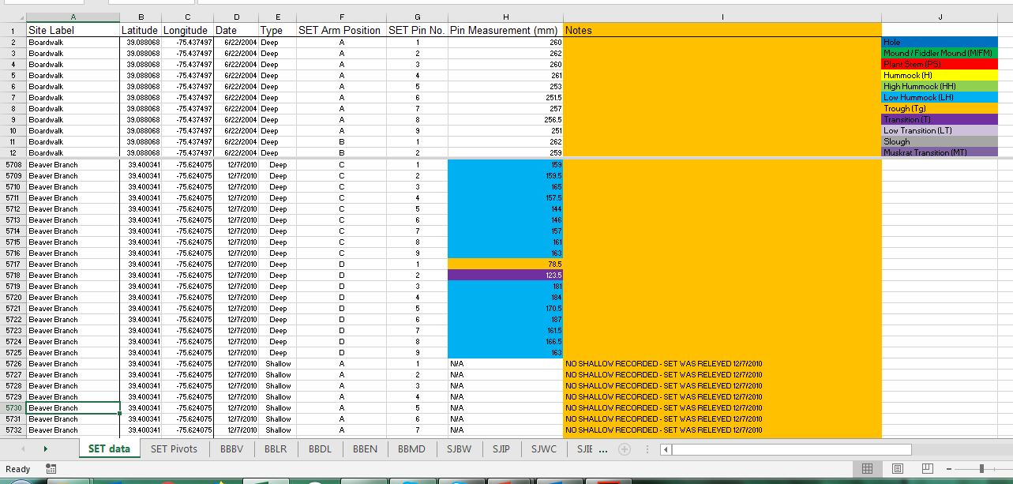
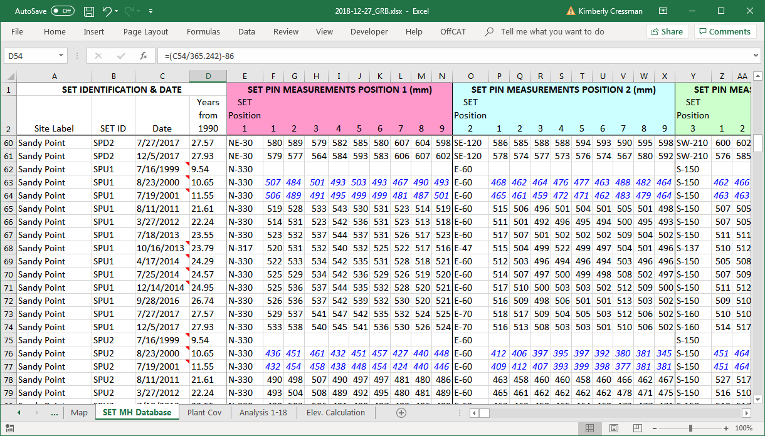
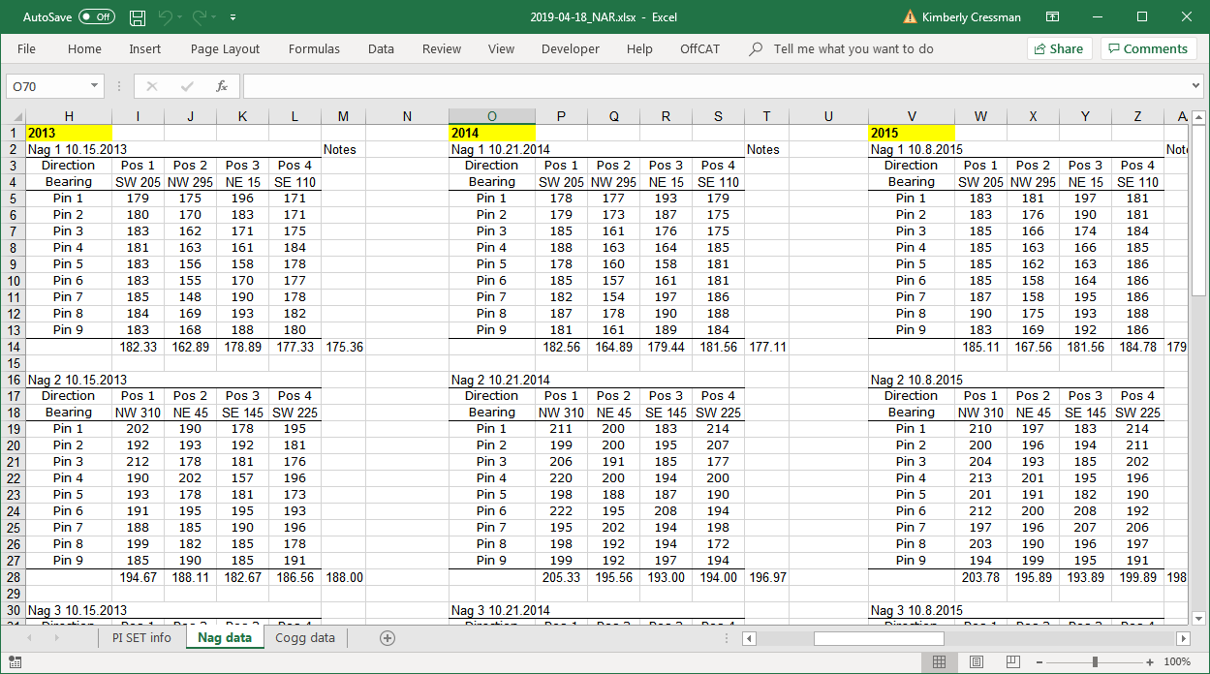
Using R to analyze, understand, and communicate tidal wetland data
Working example: https://github.com/swmpkim/SETr_example_reserve_pkg
back to
cover slide
more info
Dealing with Data
individual scripts to get each unique data format into new, standardized “raw” format
Human-friendly data entry
need to minimize data entry error
with 36 measurements per date, this was easiest to do by dividing into 4 rows per date – the rows correspond to positions of the measurement device
Computer-friendly tidy file
used to generate all other outputs in the workflow

Slide 3
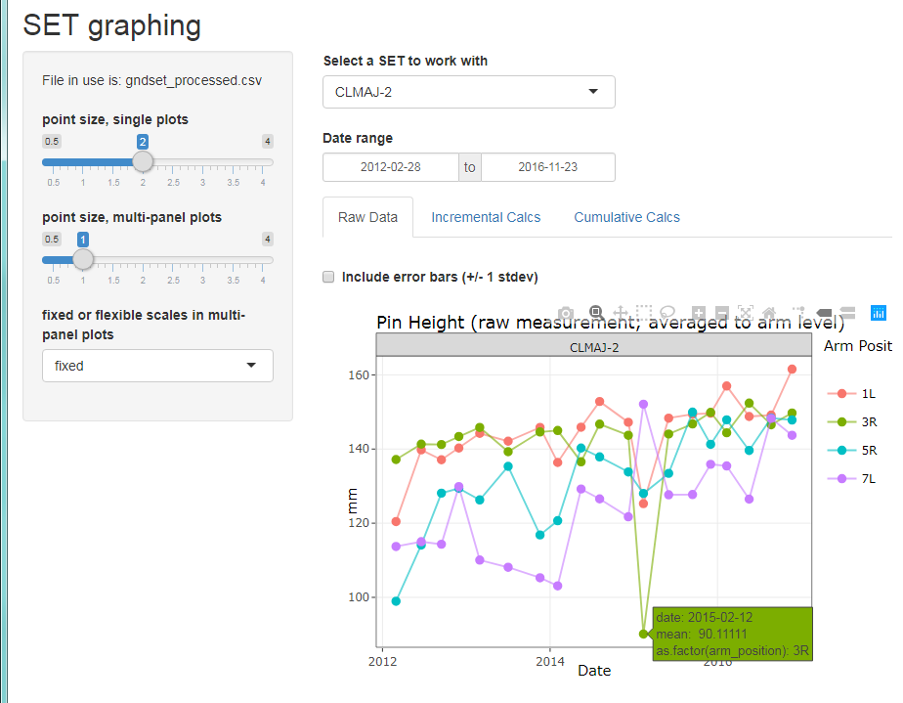
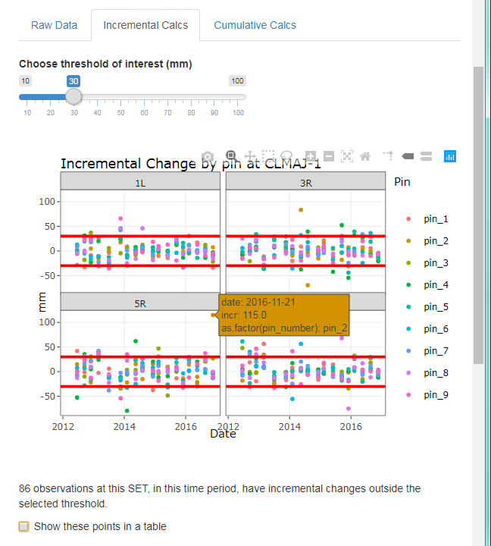
Using R to analyze, understand, and communicate tidal wetland data
Working example: https://github.com/swmpkim/SETr_example_reserve_pkg
back to
cover slide
more info
Choose which site to work with
look for outliers; hover over a point for its details
adjust the look of the graphs
Check for large differences between readings
count and show problem points in a table
shiny app for interactive QA/QC

Slide 4
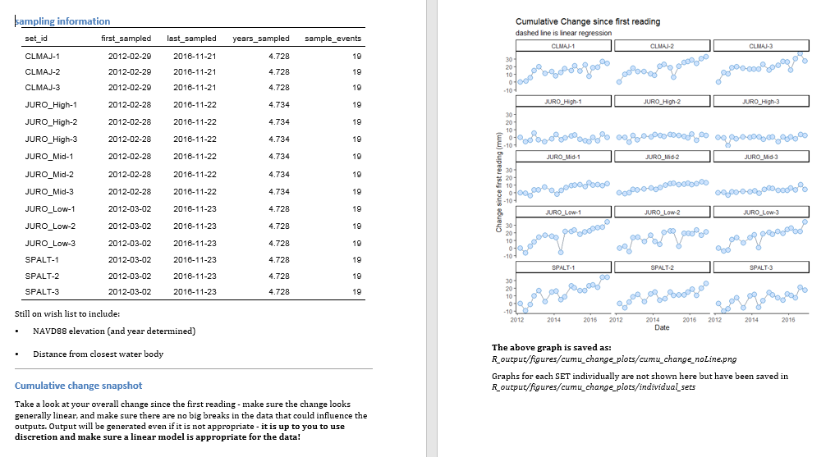
Using R to analyze, understand, and communicate tidal wetland data
Working example: https://github.com/swmpkim/SETr_example_reserve_pkg
back to
cover slide
more info
Analyze and Visualize
generated reports are in Word because users know how to edit .docx files – can remove figures, modify descriptions, and make other changes as needed
figures in report also saved as .png files, with file location indicated in document
above left: Sea level change (red line) is similar to change in marsh surface at the SET (blue line). This is good – it means this marsh is not drowning (yet).
above right: Sea level is increasing much faster than the marsh surface – this area could be in particular danger from sea level rise.
left: page spread in the Word output

Slide 5
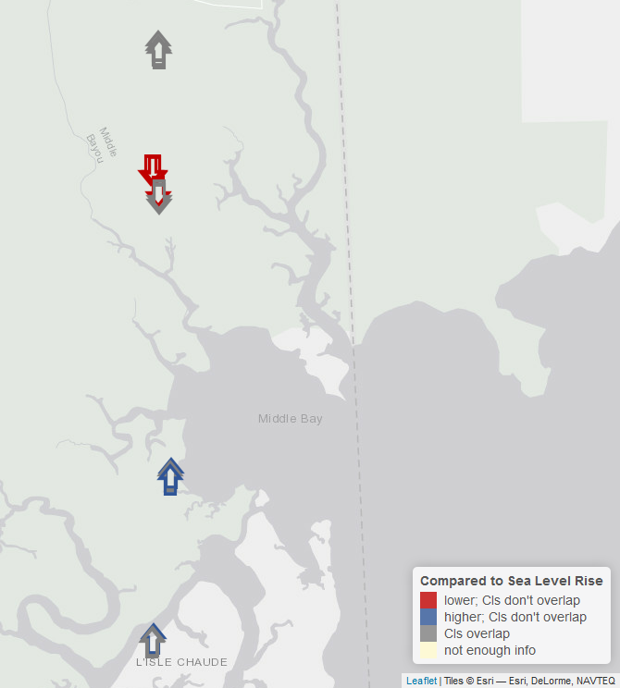
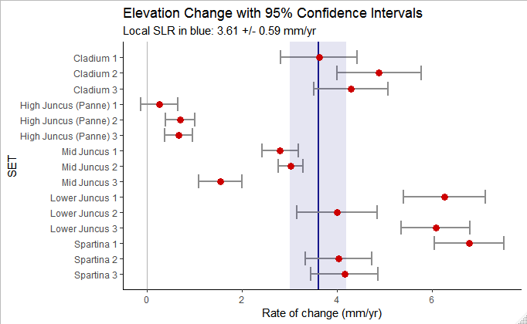
Using R to analyze, understand, and communicate tidal wetland data
Working example: https://github.com/swmpkim/SETr_example_reserve_pkg
back to
cover slide
more info
Analyze and Visualize
summaries for the entire reserve: how does each SET’s surface change compare to the rate of sea level rise?
marsh surface not keeping up with sea level rise
moving “uphill”
from bottom to top in both figures here
marsh surface change exceeding sea level rise

Slide 6
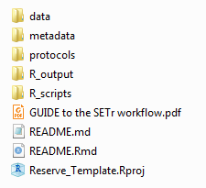
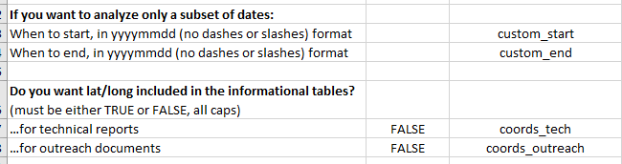
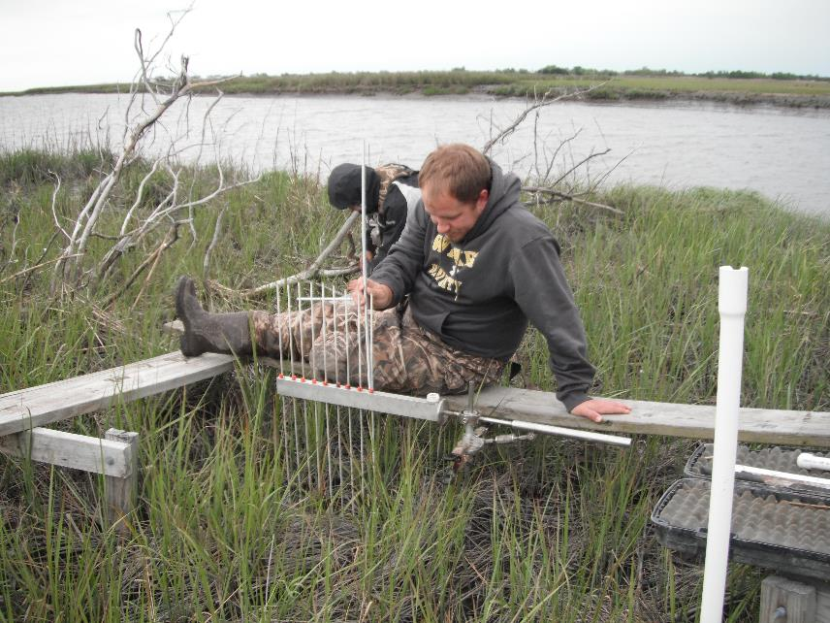
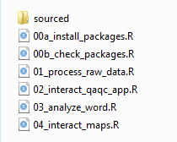
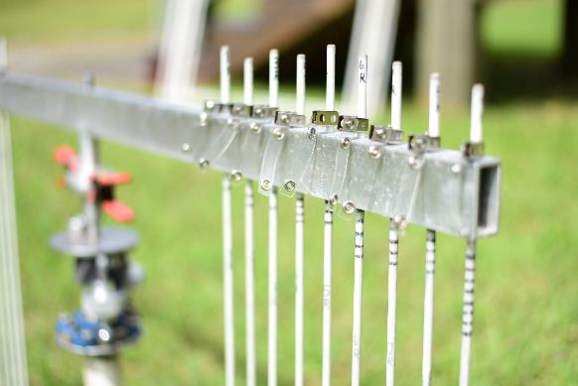
Using R to analyze, understand, and communicate tidal wetland data
Working example: https://github.com/swmpkim/SETr_example_reserve_pkg
back to
cover slide
more info
Thinking about the USERS:
File setup and inputs
Entire Directory is unified and portable
Excel file for users to define options
Directory is self-contained, thanks to .Rproj and the here package
Descriptive file names: what do I do with this script?
Instructions in many places
photo credits: middle, Sandra Huynh;
right, Delaware NERR

Slide 7
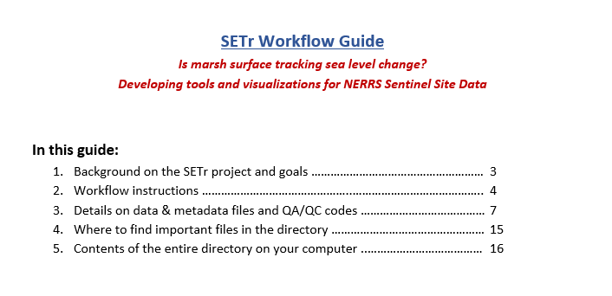
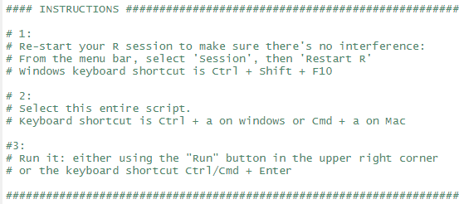
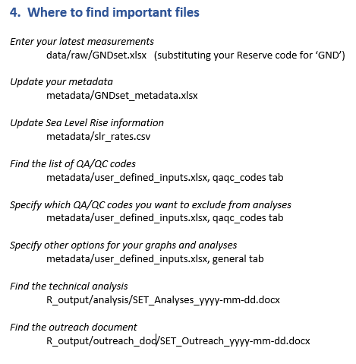
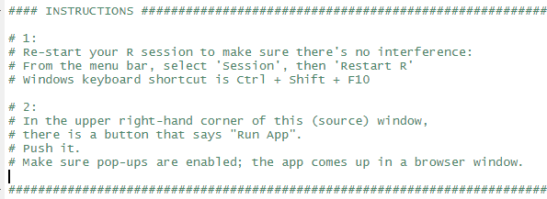
Using R to analyze, understand, and communicate tidal wetland data
Working example: https://github.com/swmpkim/SETr_example_reserve_pkg
back to
cover slide
more info
Thinking about the USERS:
Instructions everywhere
Beginning of every script tells how to use it
top: analysis script
bottom: shiny app
Workflow guide in top level of directory
20 pages = balance of short-enough-to-actually-skim and thorough

Slide 8
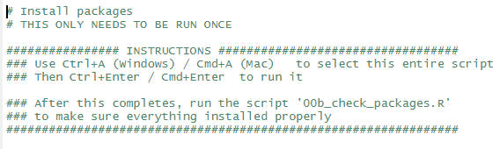

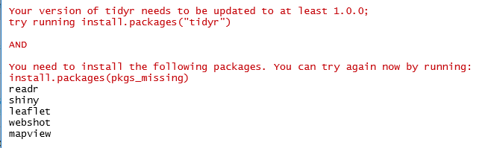
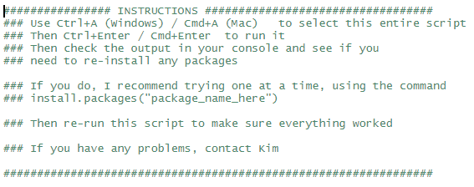
Using R to analyze, understand, and communicate tidal wetland data
Working example: https://github.com/swmpkim/SETr_example_reserve_pkg
back to
cover slide
more info
Thinking about the USERS:
Installation help
The goal isn’t to make R programmers out of people, but to enable them to use tools built using R.
Installation is a pain point that can scare people away!
These scripts aim to minimize that pain by not making people pick through a long string of error messages to figure out what didn’t work.
Again: instructions everywhere!
Installation script
Script that checks installations
Script to (helpfully) check package installations
Indicate success
Or provide helpful messages and advice if something is wrong

